Slide 1
Python for Data Science workshop
Diegem, 17-10-2018
Jeroen Dhondt & Alain Issa

Slide 2
Agenda
Introduction
The theory – presentation ~ 30 mins
Fooood!
Workshop
Guided exercises in Jupyter Notebooks

Slide 3
Introduction
Jeroen Dhondt:
Java Web developer
Joined Capgemini in 2016
Currently at Degroof Petercam
Email: jeroen.dhondt@capgemini.com
Alain Issa:
Junior Data Engineer
Joined Capgemini in end 2017
Currently at Airbus
Email: alain.issa@capgemini.com

Slide 4
Why Python
The benefits of the Python programming language:
Easy to learn .. and use
Rapid development
Wide support of libraries
Statistics and mathematics: NumPy,
Data Science and Big Data: SciPy, SciKit Learn, ..
AI: TensorFlow
Notes:
Easy to learn: no types required, simple syntax
Lightweight development environment

Slide 5
Python: where does it shine?
Repetitive tasks on large number of files
Large data set
Complex manipulations
Easy to read and perform same task on different files
Allow for automation(monthly reports / recurring files / .. )
Combine data from various sources with ease
Excel cannot handle really large data sets
Python’s libraries are optimized for it
Only read and manipulate the data you want
Automate much of what can only be done manual in Excel
Specialized algorithms are not available in Excel, many libraries available in Python
Functions in Python = allow very customizable actions
Notes:
Repetitive tasks:
Monthly financial reports=> combine data, automate certain
Large data:
Analyze and perform data check on large sheets of information and write reports / clean up those values

Slide 6
Quick recap: Data Structures
Data types
string (‘Hello world’) , integer (1), float (3.14), Boolean (True)
List
list_of_values = [‘value1’, 2, ‘another’, True, None]
Dictionary
dict = { “name”: “Garfield”,”Age”: 12,”Favorite food”: “Lasagne” }
Dict[“name”]
Loops
for x in list:
print(x)
Conditionals
if value > 0 : else:

Slide 7

Pandas: introduction
Open Source Python library
Easy-to-use data structures
Very well suited for tabular data such as Excel and databases
High-performance data analysis tools
Running on top of NumPy and SciPy, two excellent libraries for data science
NumPy: low level library that contains highly optimized data structures for large data (on top of C)
SciPy: mainly used for scientific computing: optimization, linear algebra, integration, interpolation, signal and image processing
Notes:
NumPy + SciPy

Slide 8
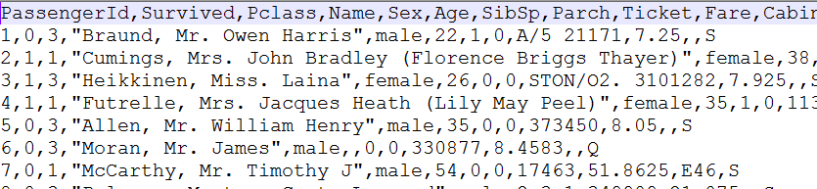
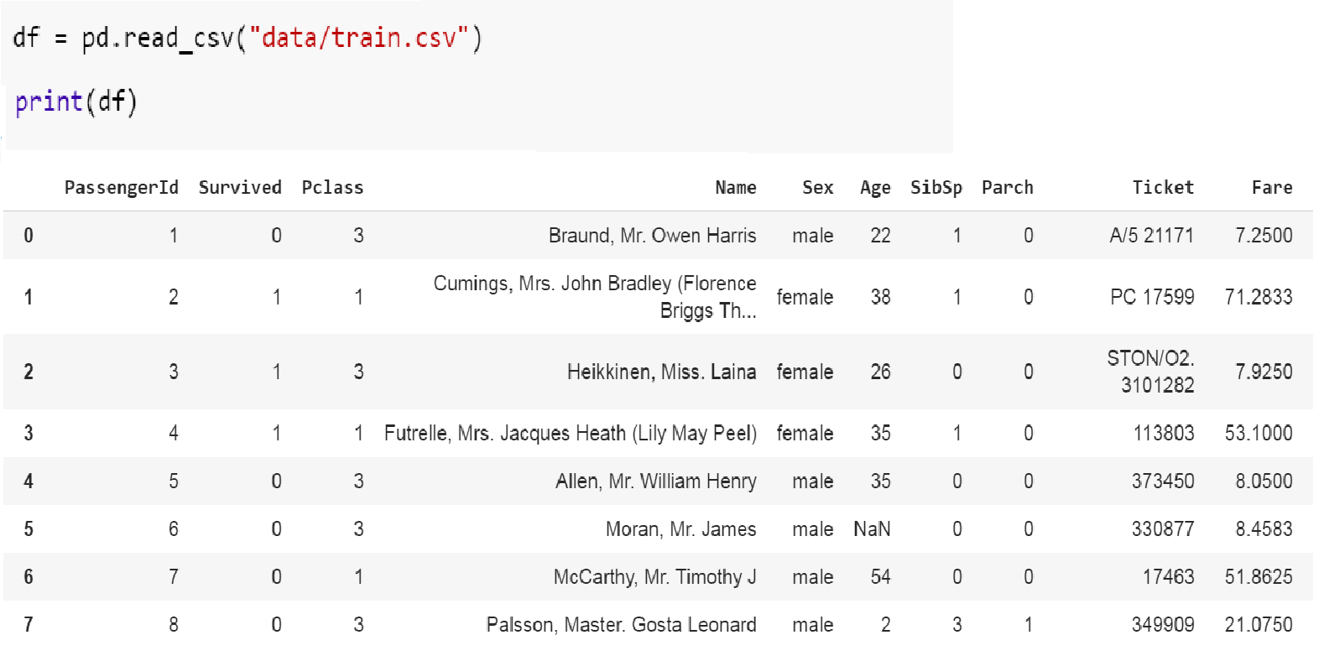
Reading data
Many formats are supported:
Text / Comma-separated values (CSV)
pd.read_csv("titanic.csv")

Slide 9
Reading data
Different sources, same syntax!
Text / Comma-separated values (CSV)
pd.read_csv("titanic.csv")
Excel sheets
pd.read_excel("titanic.xlsx", sheet_name="sheet1")
Database
Table: pd.read_sql_table("data", con="porstgres:///titanic")
Query: pd.read_sql_query("SELECT * FROM data WHERE survived = 1", con="porstgres:///titanic")
Many others including SAS, Stata, JSON, HTML ..
See https://pandas.pydata.org/pandas-docs/stable/io.html
Writing data back: use .to_<output-format>
Example: df.to_csv("results.csv", sep=";")

Slide 10
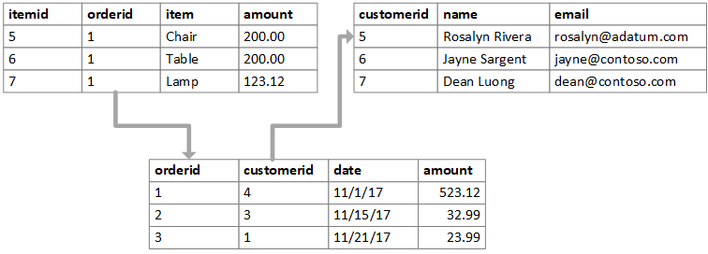
Introducing a database
A database is specially designed to store and retrieve large numbers of information
Tables ~ excel sheet
Relation model describes the fields and it’s links
Interconnected through foreign keys
Make requests to DB for specific data through queries
Structured (SQL) queries example: SELECT PassengerId,Survived,Name from titanic WHERE age > 25 ORDER BY Name
Notes:
You can see it as a set of connected

Slide 11
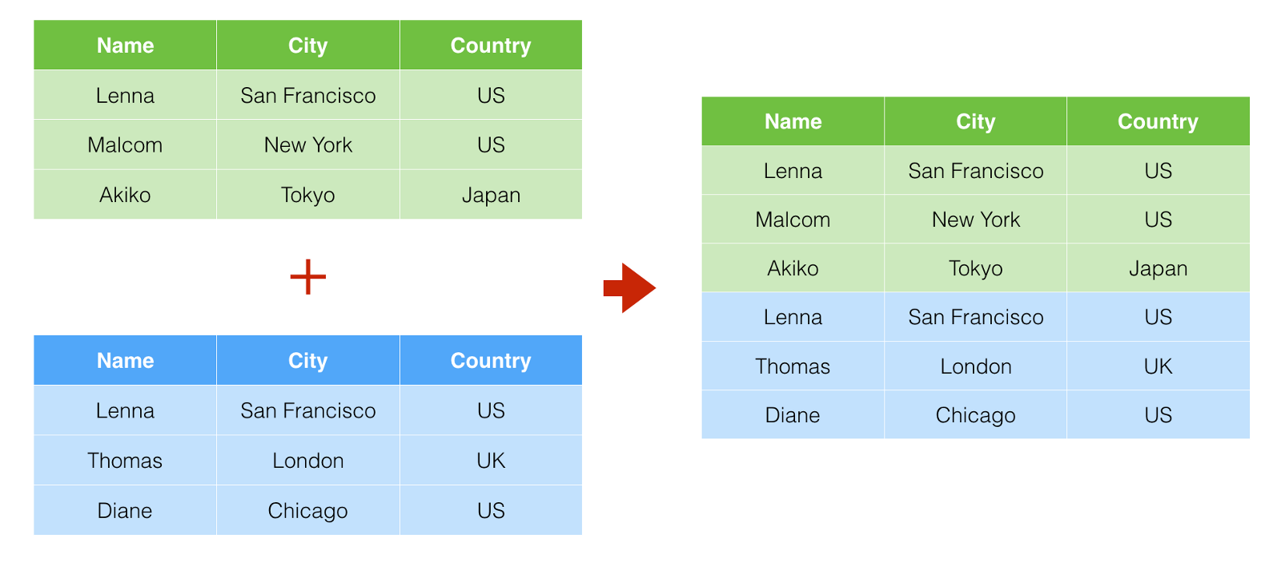
Common operation on Tables
Mainly three operations:
Filter ➔ retrieve only a subset of the data based on some condition (e.g. take rows that only have non null values)
Union ➔ “Concatenate” two table in order to make one big table (Be careful to have the same column/format for both table!).
In Pandas we can use “concat”
Notes:
You can see it as a set of connected

Slide 12
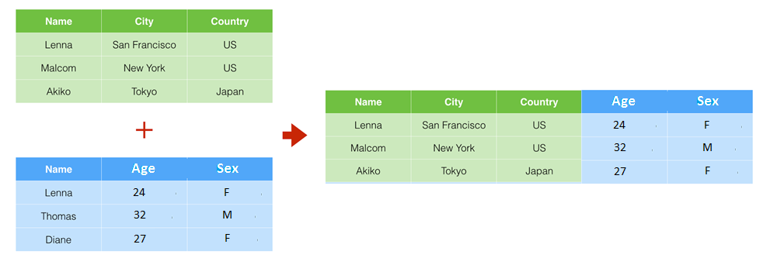
Common operation on Tables (2)
Mainly three operations:
Join: It is used to combine rows from two or more tables, based on a related column between them.
This is a very common case: data is spread over multiple tables / data sources
Notes:
You can see it as a set of connected

Slide 13
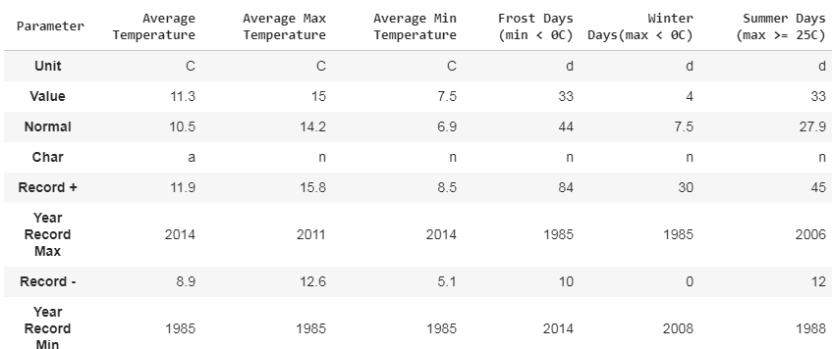
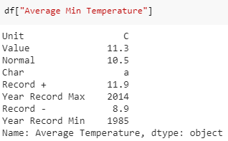
Pandas’ data structure
Columns
DataFrame
2D labeled data structure
Contains Series
Series
1D labeled array
1 Series
Indices

Slide 14
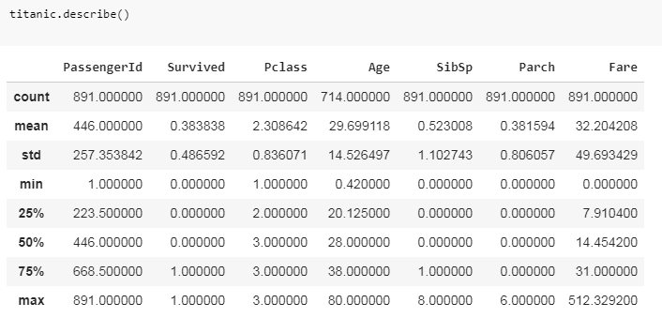
The magic of Pandas
Processing the data
Select subset of columns (‘slicing’)
Rename labels and conditional changing values
Filtering and cleaning of data
One-line operations:
Sorting values
Average, std, quantiles
Print general statistics + much more through SciPy
Joining diffent data sets
…

Slide 15

Set up your own environment to experiment
Install Anaconda locally:
Install Anaconda, download it here: https://www.anaconda.com/download/
Anaconda Navigator > Open Jupyter Notebook
Find the latest notebook here: https://preview.tinyurl.com/capgemini-workshop-2 or find it in Microsoft Teams
Load it as a notebook, and you are set!
Open the notebook in Google or Windows Azure
Ask our help so we get you started

